Slide 1

Semester-I “play to win”
Subject : Python for Computational Problem Solving (PCPS)
Subject Code: UE23CS151A
MiniProject
Python mini project
Team details:
Shrujani s –pes2ug23cs570
Shrusti patil -pes2ug23cs571
Surabhi V -pes2ug23cs632
Tejashwini v n -pes2ug23cs649
Under The Guidance Of:
Prof.Arpita Chaudhari
Asst.Prof
Dept.Of CSE
PES University

Slide 2
OUTLINE
Problem Statement
Team roles and Responsibilities
Implementation details-Pseudocode / Algorithm
Snippets of Code
Results and Discussions
Learning about the project
Conclusion
Future work
References

Slide 3


Problem statement
# OF COURSE WE ALL ARE ON PAR WITH MANY THINGS AROUND US!!
# BUT HOW FAB ARE WE TO HAVE A STAB AT FEW BASIC QUESTIONS..
# OPPORTUNITY FOR PEOPLE TO EARN MONEY AND BENEFIT THEIR HOUSEHOLD.
# IT IS INTENDED TO UPLIFT FUN LEARNING METHODS WHILE ALSO ENHANCING GENERAL KNOWLEDGE.
# STUDENTS AND OTHERS INTERESTED CAN “THINK OUTSIDE THE BOX”.

Slide 4


Team ROLES AND RESPONSIBILITIES
SHRUJANI S
SHRUSTI PATIL
SURABHI
Tejashwini v n
SRN-PES2UG23CS570
Back-end coding
Images research
SRN-PES2UG23CS571
Modules research
Appearance development
SRN-PES2UG23CS632
Back-end coding
PPT making
SRN-PES2UG23CS649
Appearance development
Modules research

Slide 5

List of modules
OVERVIEW:
Tkinter:
Title
Geometry
Label
Button
Frame
PhotoImage
ProgressBar
Bind
TopLevel
Pygame
Pyttsx3
In-Built modules like: insert, delete, destroy, get, etc.

Slide 6
Tkinter: It is used to construct Graphical User Interface (GUI). In our project it is used to code background colour, labels, option button, etc.
Pygame: It is used in development of multimedia application. In our project we have used it for music.
ProgressBar: In our project it is used to know the percentage of people voted for each option.
Bind: It is used to connect an event passed in the widget along with the handler.
TopLevel: Used to import all other modules that the program needs.

Slide 7
Algorithm / pseudocode
Once we run the code, it directs us to the quiz page.
Can click one of the 4 options:
If correct, moves to next question.
If wrong, it displays an appropriate message and exits the loop.
3 lifelines are available with the user.
Upon using a lifeline, it becomes obsolete.
In the end it displays the amount of money earned.
Exit.

Slide 8
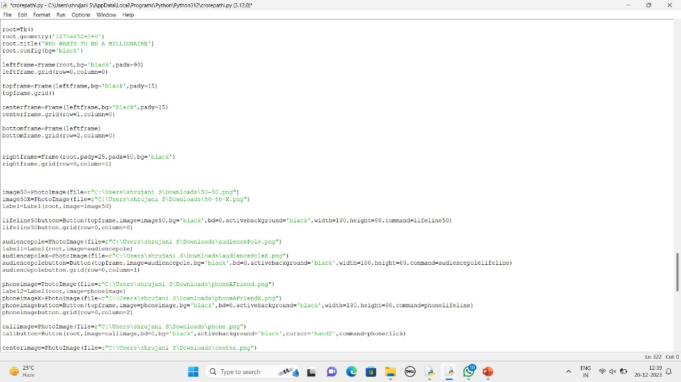
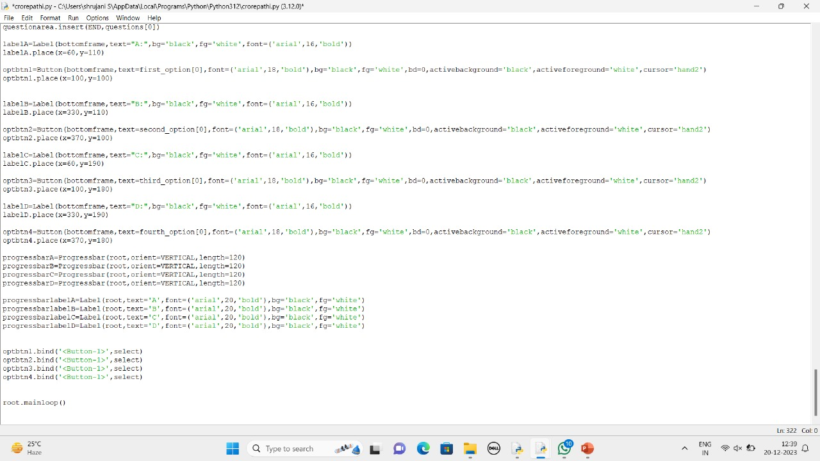
Snippets of code

Slide 9
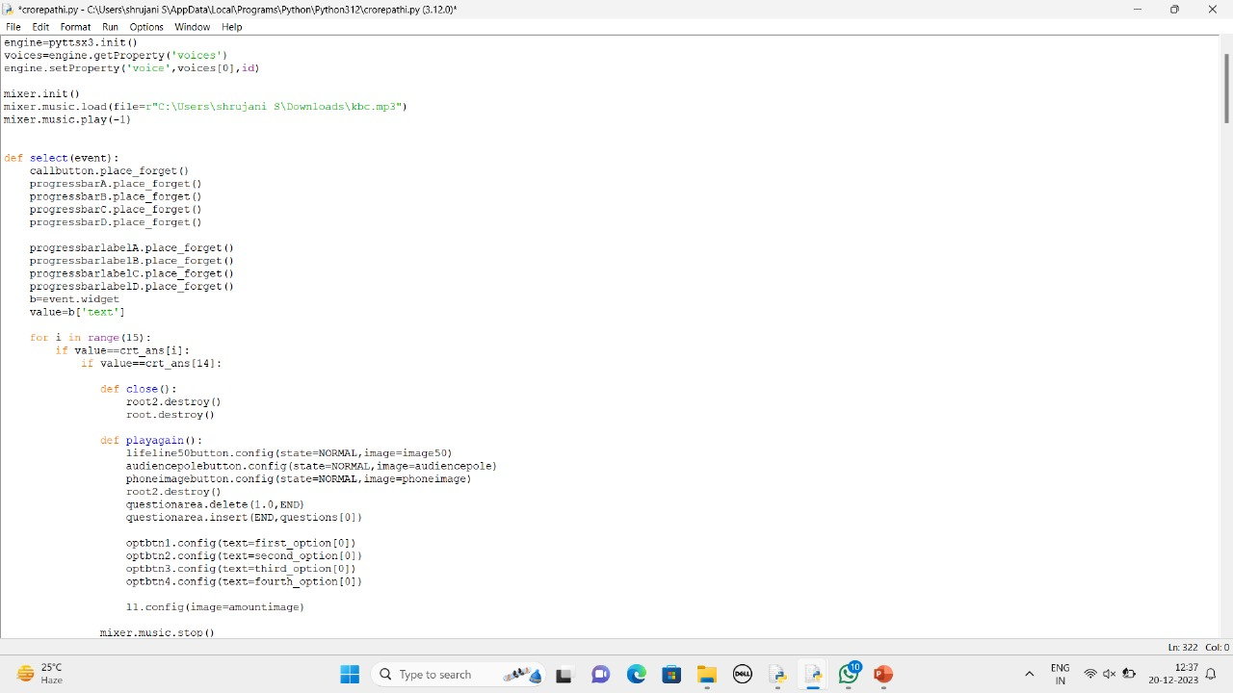
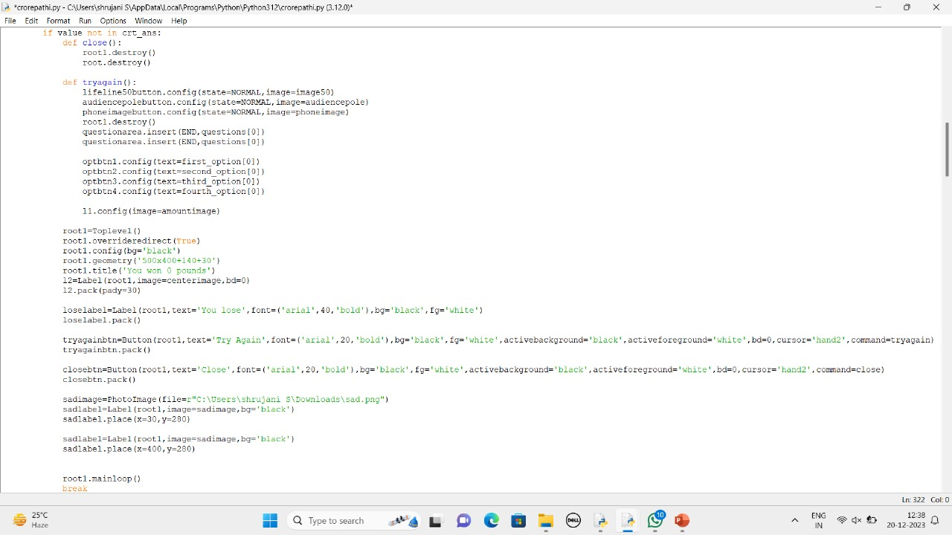

Slide 10
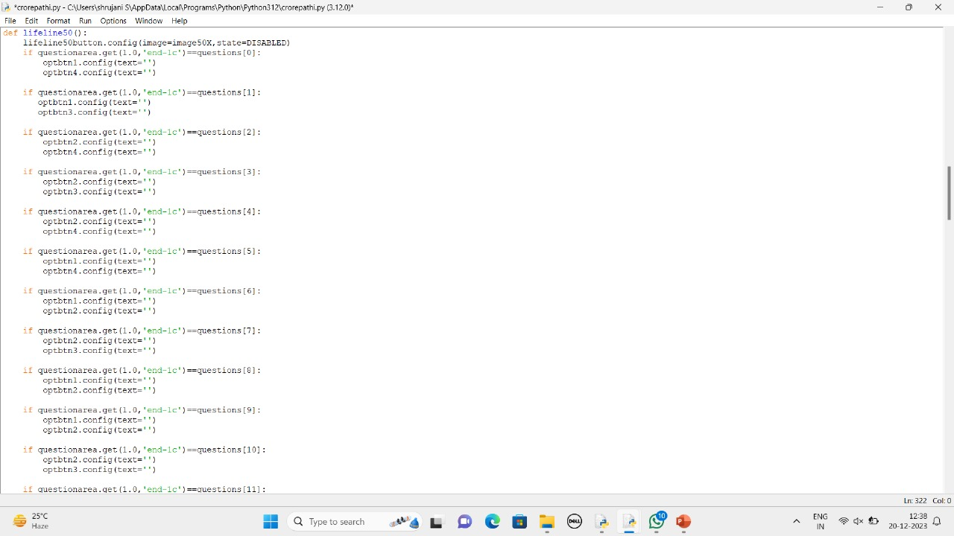
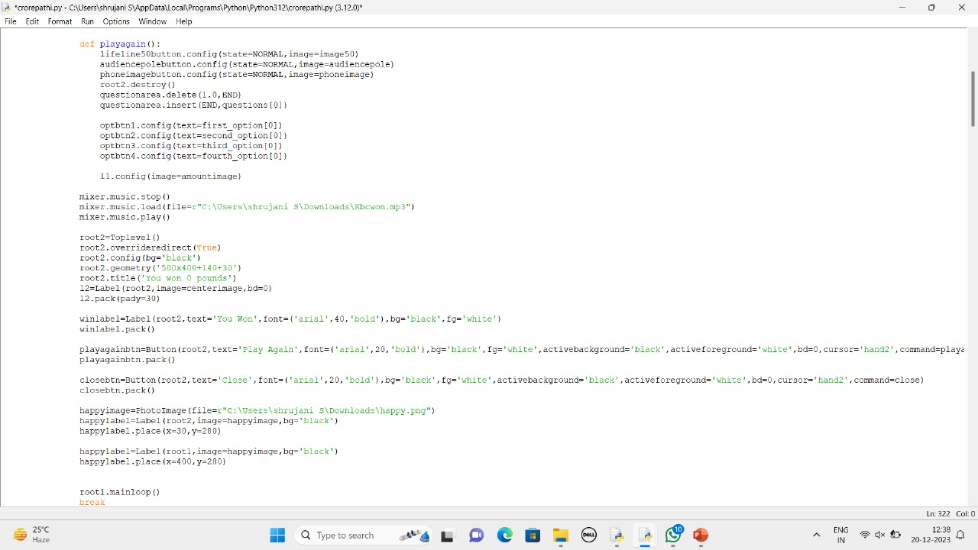

Slide 11
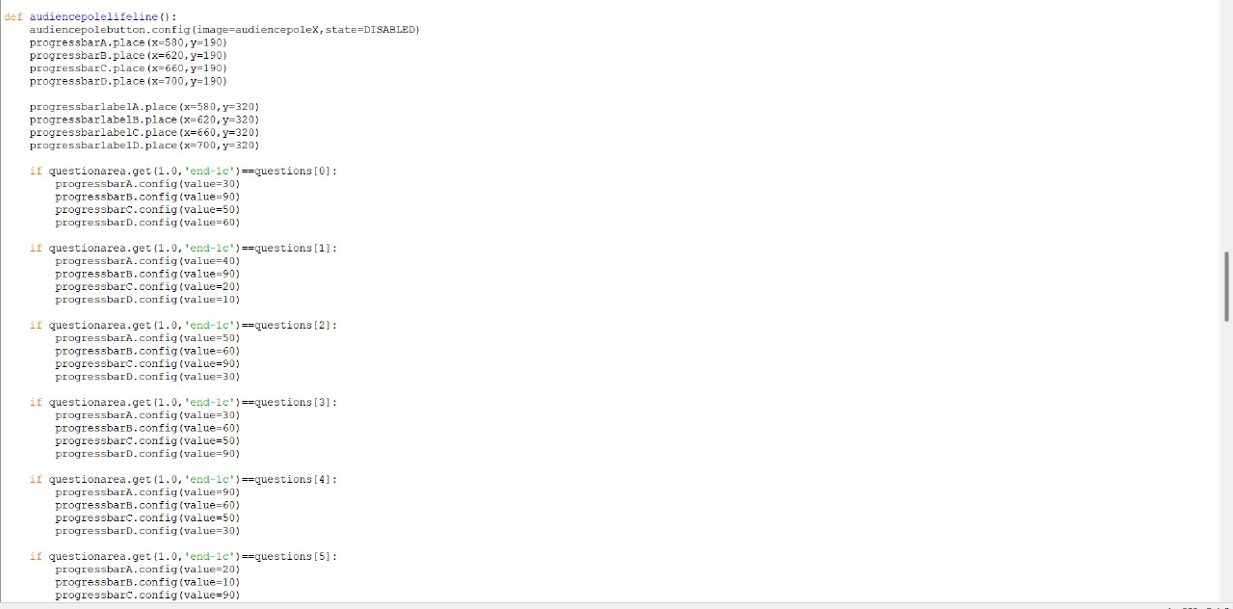

Slide 12
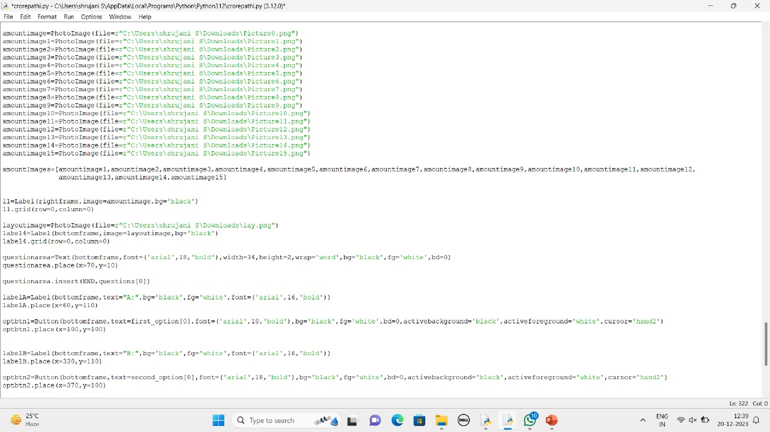
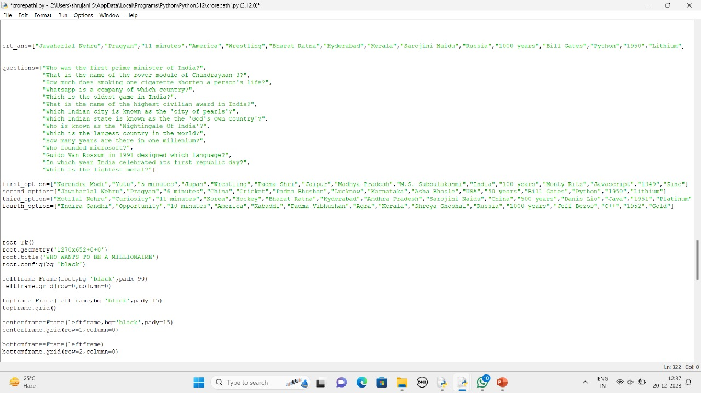

Slide 13
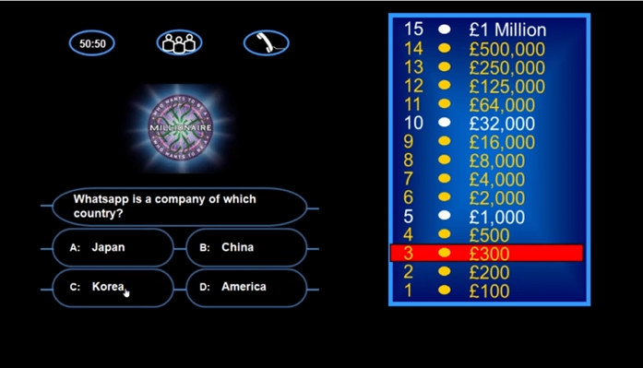
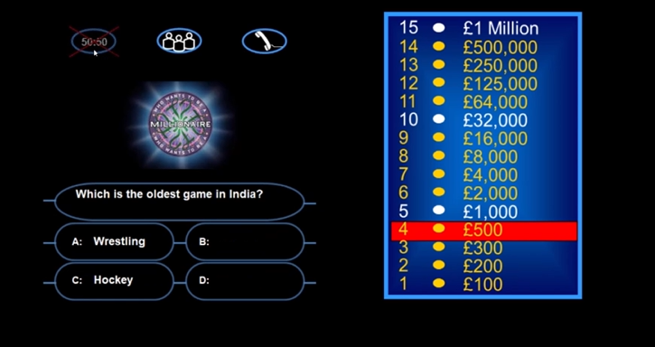
Results and discussions

Slide 14
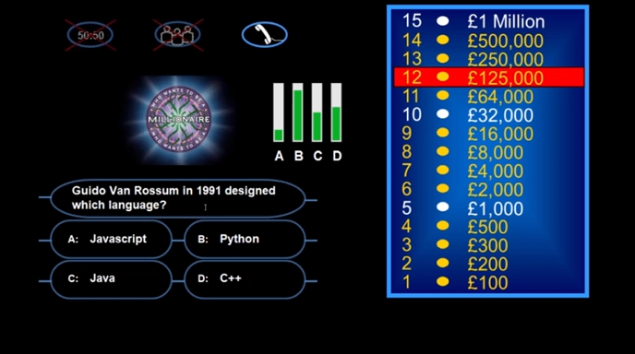
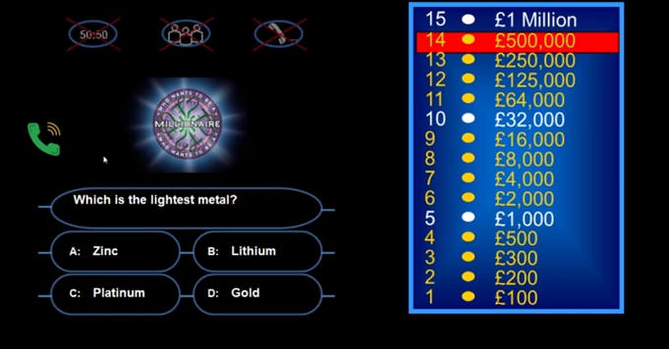

Slide 15
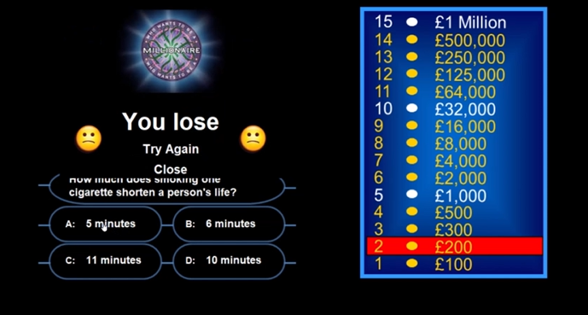
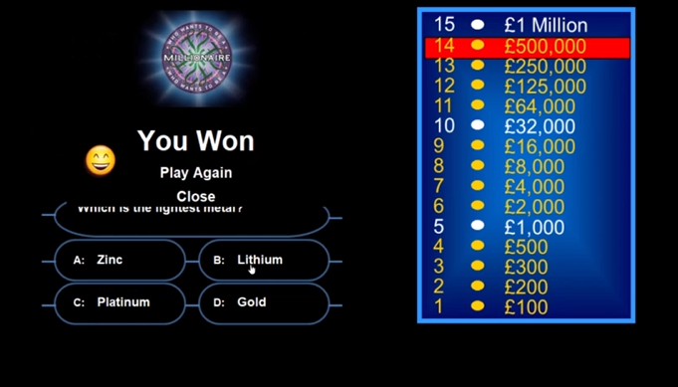

Slide 16
Learning from this project
General Knowledge
Team Work
Real life application of theory
Modifying background colour, dimensions, etc.

Slide 17
Future SCOPE
Modified to work as digital flashcards thus proving a good revision mode.
Can be modified to include various genres and a choice to choose different ones.
Option to include playing with multiple users at a time.

Slide 18
Conclusion
Unique features:
View position in the game to your right, i.e. displays progress in the form of amount earned.
Option of using three lifelines: 50-50, Audience pole, Phone a friend.
Option of playing phone ringtone when phone-a-friend lifeline is used.

Slide 19
References
YouTube links:
https://youtu.be/uj_52lCH4I8?feature=shared
https://youtu.be/Cde7yyweeto?feature=shared
https://youtu.be/hQWcIWj8mbI?feature=shared
Google
ChatGPT

Slide 20


